Slide 1
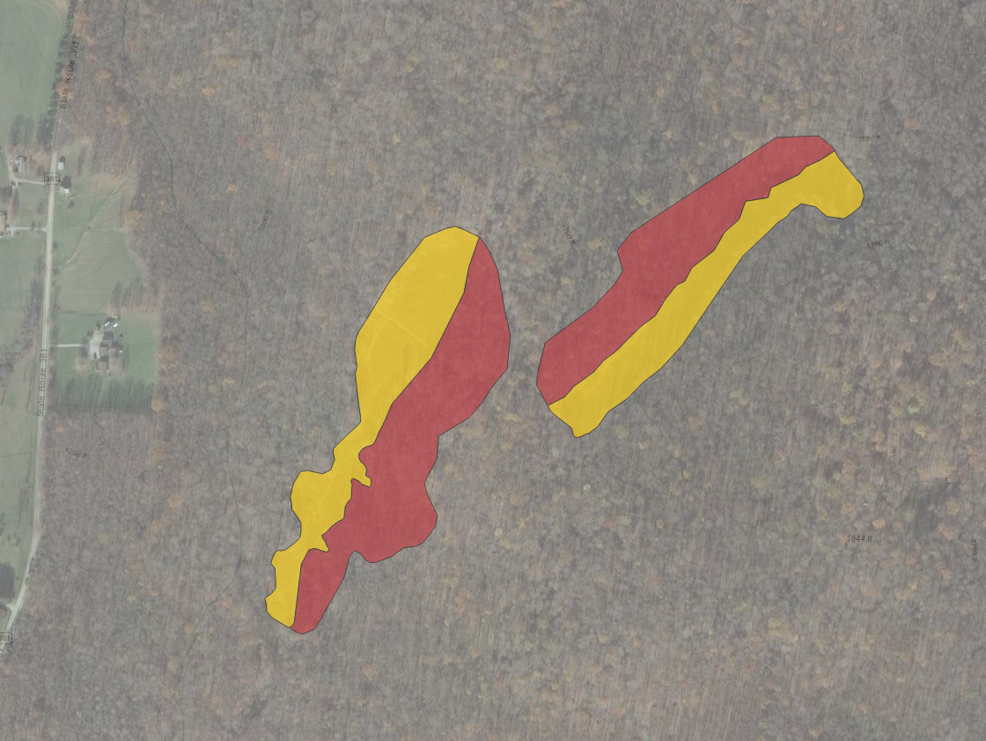

Slide 2
Treatment
Windthrow
Salvage-logged
Forest control

